Slide 1



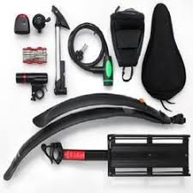



ADVENTUREWORKS
By- Priyanshi
Course project :Maven Analytics

Slide 2

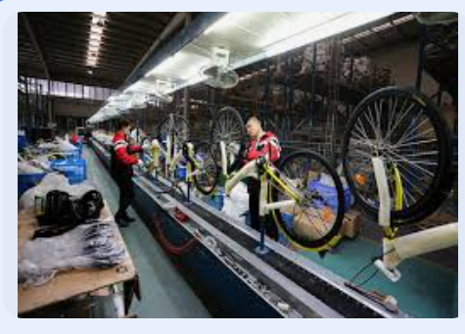


ADVENTUREWORKS
A Global manufacturing Company produces Cycling Equipment and accessories.

Slide 3

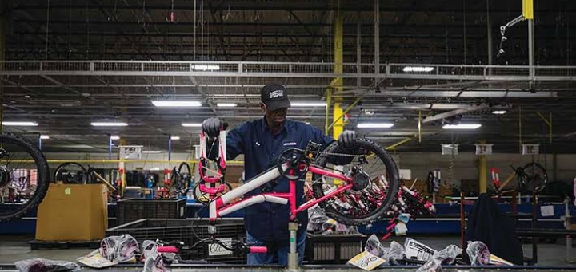
Objective
Data Integration and Transformation - Connect to raw CSV files containing transaction, product, customer, and sales territory data, and apply advanced data cleaning techniques to prepare it for analysis.
Relational Data Modeling - Construct a robust relational data model that establishes clear relationships between datasets, ensuring seamless data flow and accurate analytics.
. Advanced Calculations with DAX - Develop dynamic KPIs and measures using DAX to track essential metrics like sales, revenue, profit, and returns, providing actionable insights into business performance.
Interactive Dashboard Design - Build an intuitive and visually compelling dashboard that allows management to compare regional performance, analyze product-level trends, and identify high-value customers, empowering data-driven decisions.

Slide 4

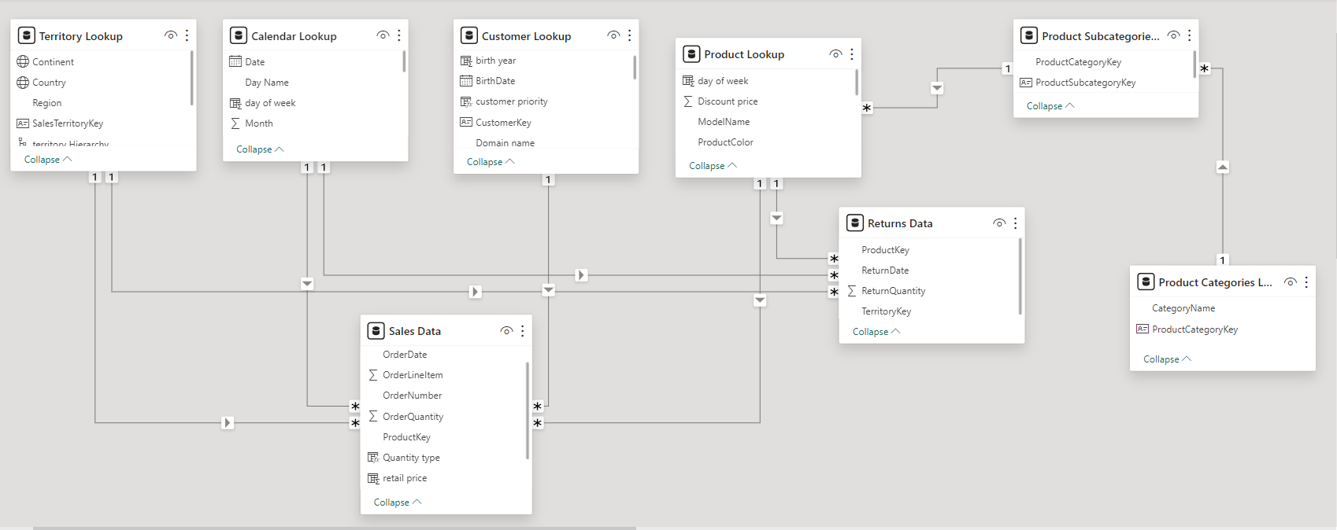
Models view and relationship

Slide 5



DASHBOARD OVERVIEW
The Revenue Dashboard provides a comprehensive view of the company's financial performance by focusing on total revenue, revenue trends over time, and monthly targets. This dashboard enables the management team to track financial growth, evaluate performance against set goals, and understand revenue patterns across different periods.
REVENUE ANALYSIS
The Product Performance Dashboard provides insights into how individual products are performing, focusing on orders by category and return rates. This dashboard is essential for managing product quality and customer satisfaction by highlighting which products drive sales and which may require improvement.
PRODUCT ANALYSIS
The Orders Dashboard focuses on understanding customer demand through total orders, category breakdowns, and monthly targets. This dashboard serves as a valuable tool for identifying demand patterns, managing inventory efficiently, and ensuring that the business can meet customer needs effectively.
CUSTOMER ANALYSIS

Slide 6
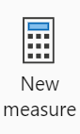
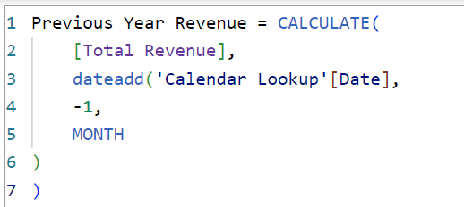
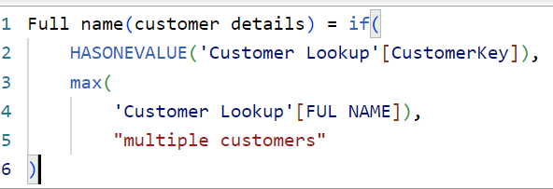
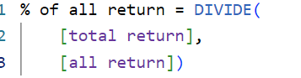
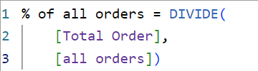
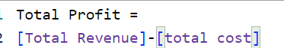


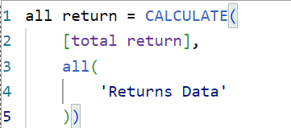
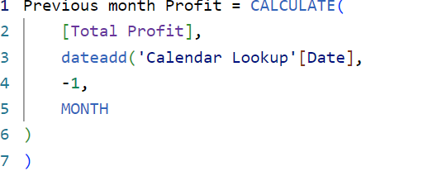
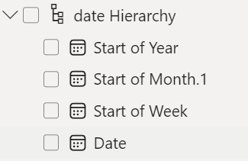
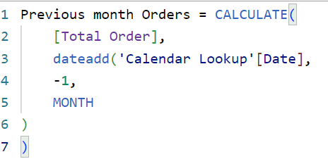
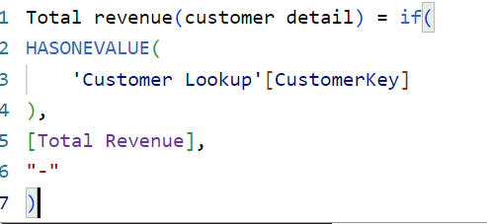
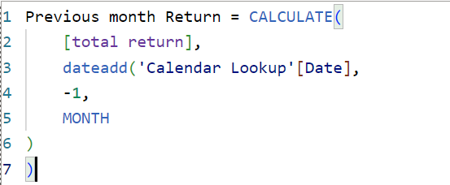

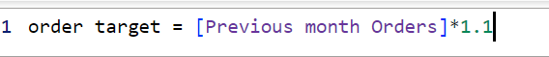
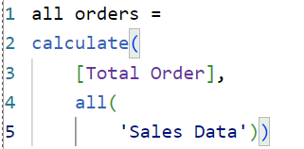
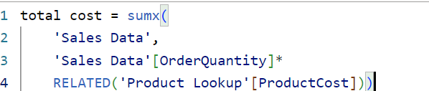
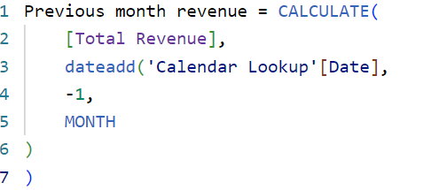
MEASURES AND HIERARCHIES

Slide 7
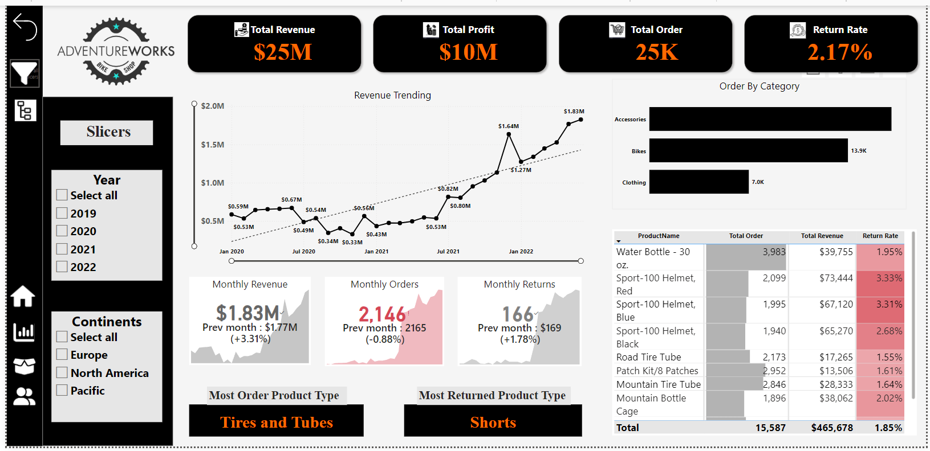

Slide 8
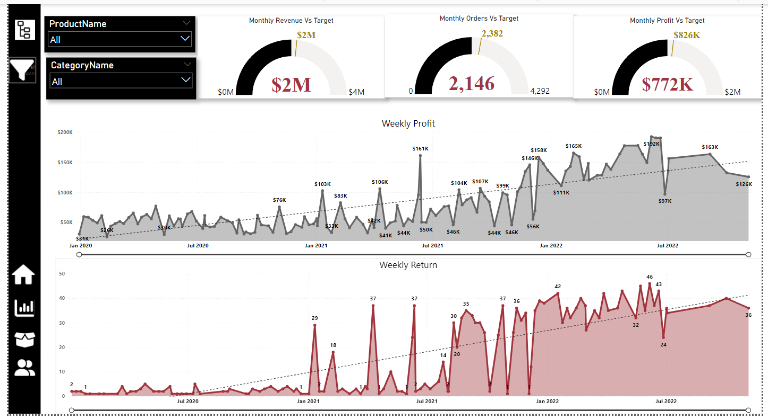

Slide 9
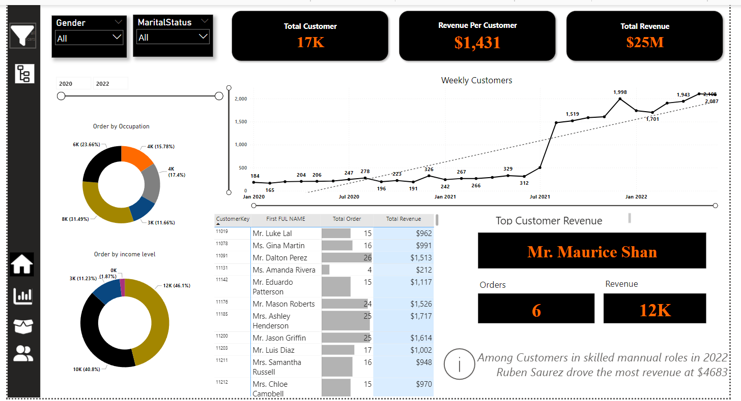

Slide 10
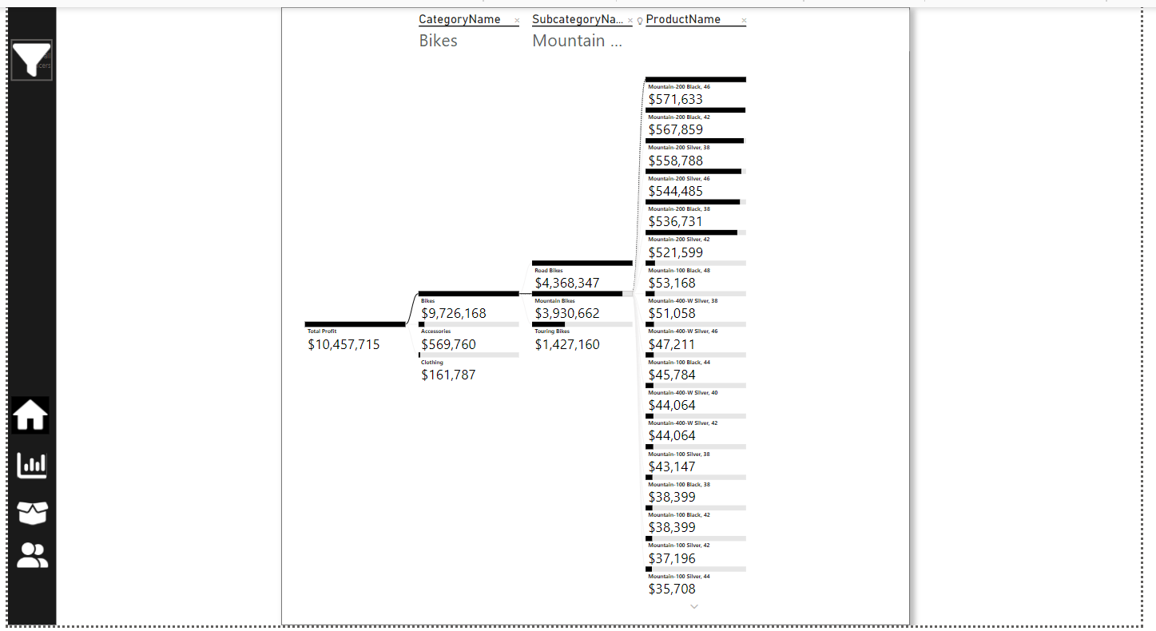
DECOMPOSITION TREE

Slide 11
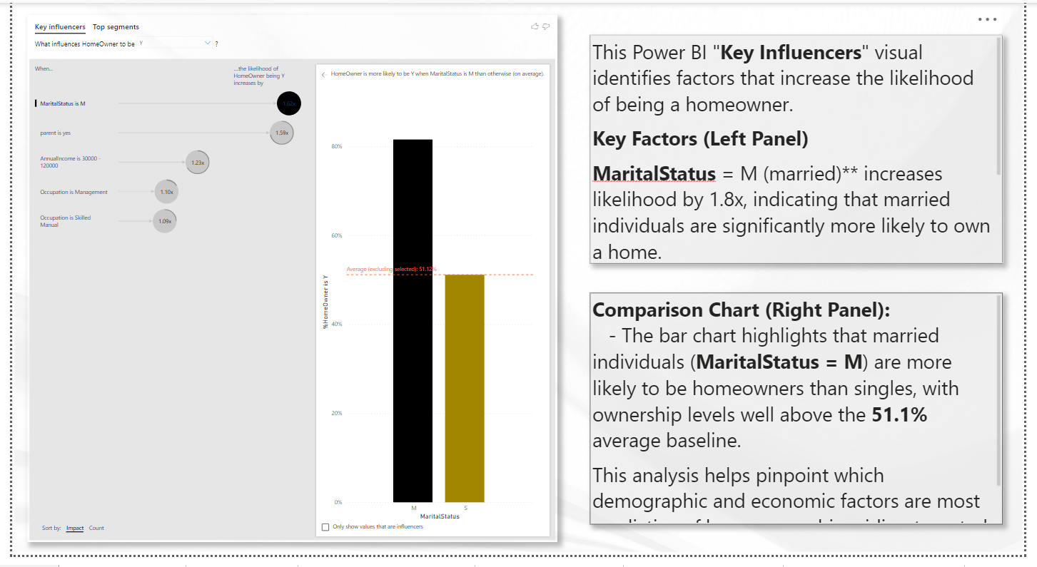
KEY INFLUENCERS

Slide 12

Recommendations
Enhance Product Quality &Customer Retention.
With a return rate of 2.17%, we’re already seeing strong customer satisfaction.
However, products like "Shorts" and the "Sport-100 Helmet" show higher return rates (3.33% for the helmet).Initiating targeted customer feedback for these items could yield insights for improvement, potentially reducing returns by up to 1% if we address common issues, leading to cost savings and better customer experience.

Slide 13
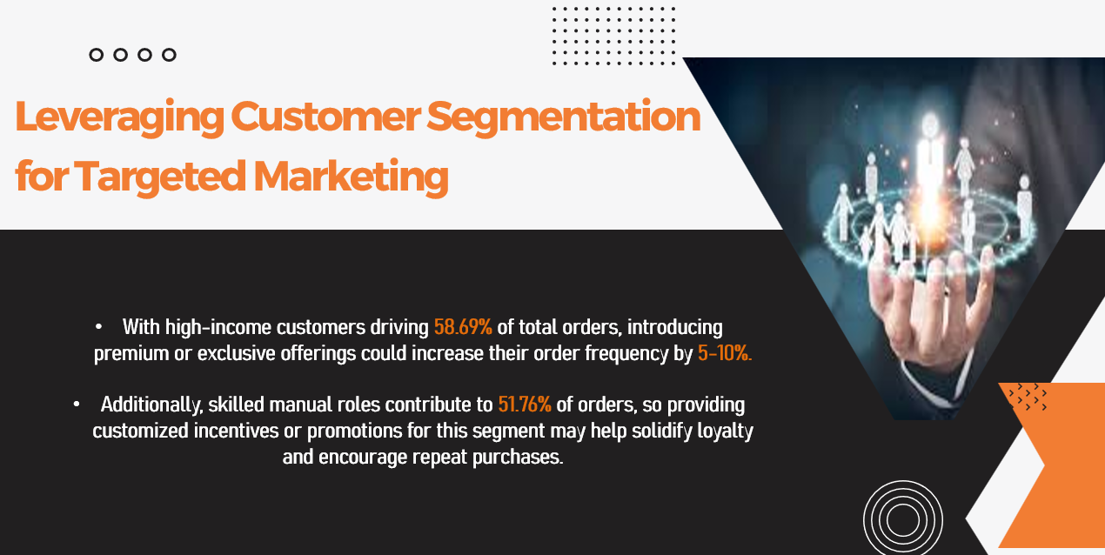

Slide 14
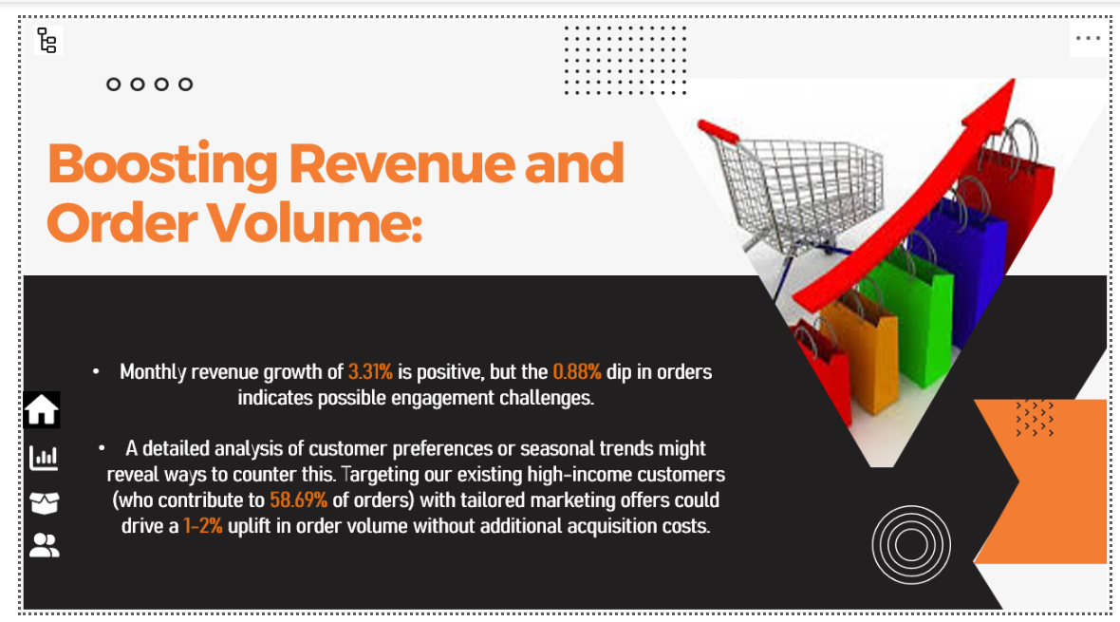

Slide 15

Product-Specific Optimization:
The "Water Bottle - 30 oz." has sold 3,983 units with a low return rate of 1.95%, indicating it’s a top performer. Increasing marketing efforts around this item could boost revenue by 5-10% in this category.
Additionally, focusing on quality adjustments for products like the helmet (currently at a 3.33% return rate) could cut returns by up to 1.5%, improving profitability and maintaining brand perception.

Slide 16




THAT’S A WRAP!
Thankyou for joining me on this journey through the project .👍🏻
I hope you found it informative and thoughtful-provoking.
LinkedIn
For further clarification and inquiries please direct your correspondence to the given details
Github
priyanshikhandelwal2107@gmail.com

